Slide 1

This PowerPoint template is intended for student use to create their Venture Capital Pitch Refer to slide notes for locations of data within the game software and other personalization options
Copyrighted in its entirety, Ernest R. Cadotte, 2018
Notes:
The PowerPoint theme (background, font, and colors) can be changed using the Design tab above

Slide 2

Bolt Cycles – Group 7

Slide 3
Team Members
Bhosale, Prathamesh
President-Overall Leadership
Mor, Rahul
VP-Accounting and Finance
Dalvi, Raj
VP-Marketing
Baghele, Prajwal
VP-Business Analytics
Dangi, Rishabh
VP-Human Resources
Sanklecha, Rickin
VP-Manufacturing

Slide 4

Mission Statement and Objectives
Mission Statement
We are committed to maintaining the most knowledgeable staff, carrying the highest quality products and providing the best possible service. We respect all levels of ability and strive to enhance every customer's cycling experience. We serve our community by increasing cycling awareness and cycling participation.
Objectives
focus on large, highly competitive segments
focus on the largest geographic markets, even if they are more expensive
build a market position and defend it
take the lead and keep it
be first to market
be the leader in all things
be the market share leader
be the profit margin leader
be the technology leader

Slide 5

Target Segments
1 – Speed
2 - Mountain
3 - Recreation

Slide 6
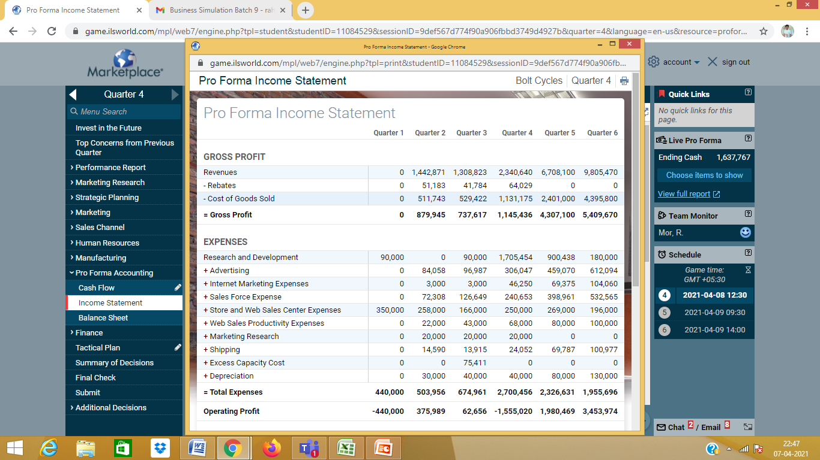
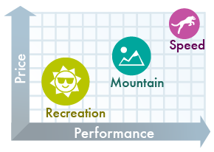
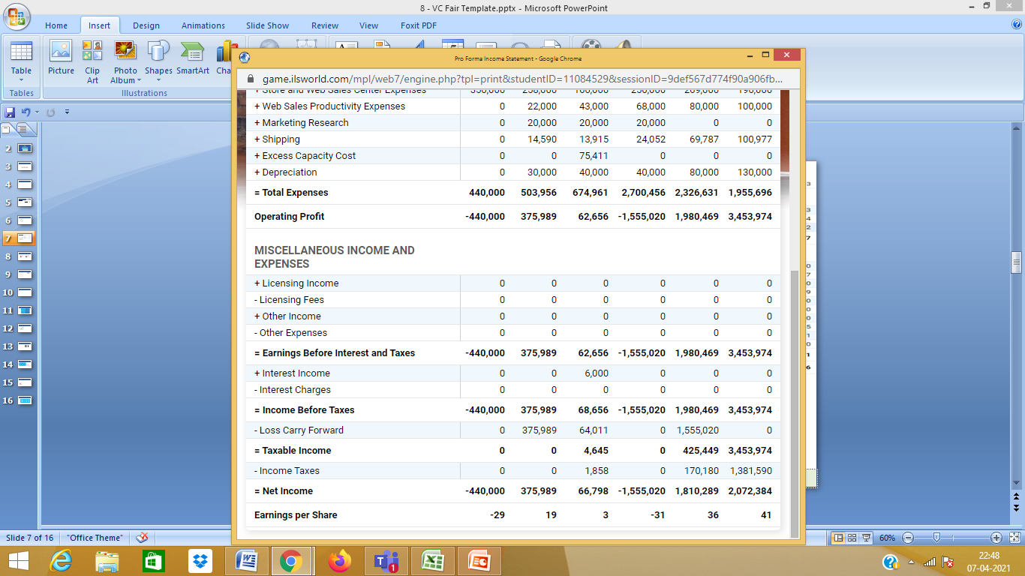
Past Financial Performance
Notes:
The income statement can be exported from the game in Quarter 4 (located under Performance Report – Income Statement). Use the export button at the at the top right of the workspace to open Excel, then copy and paste to the slide above

Slide 7
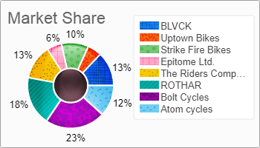
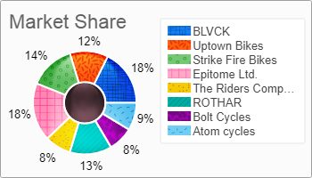
Past Market Performance
Quarter 2
Quarter 3
Notes:
The image above can be exported from the game software by navigating back to Quarter 3 (located under Performance Report – Market Share). Use the save button to save the image to your PC, then add it to the slide above.

Slide 8
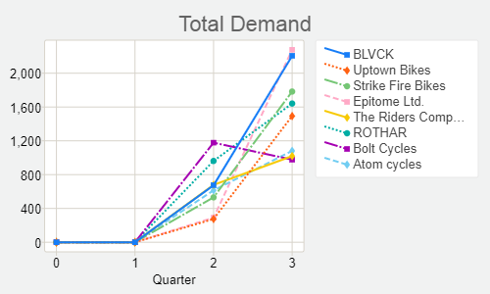
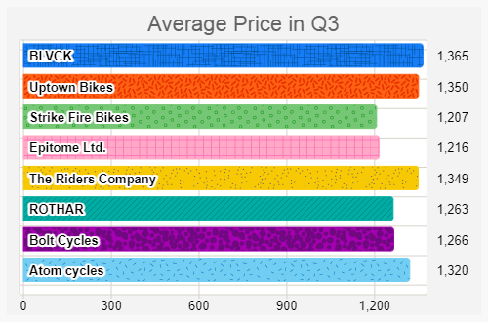
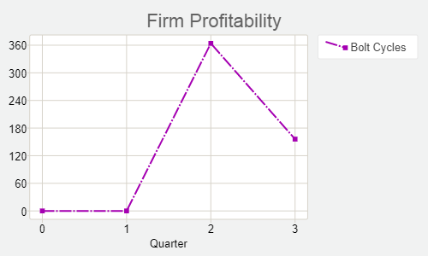
Past Performance
Notes:
The images above can be found in Quarter, under Performance Report – Strategic Graphs. Click on the individual graphs to view bar graphs as well. You can choose several graphs that highlight past performance from this section to include on the slide above.

Slide 9
Competitor Analysis
 | BLAVK | EPITOME | STRIKE FIRE | ROTHAR
Target Markets | Mtn, Spd, Rec | Rec, Mtn, spd | Rec, Mtn, spd | Mtn, spd, Rec
Total Demand | 2206 | 2277 | 1783 | 1641
Average Price | 1365 | 1216 | 1207 | 1263
Total Regional Inserts | 20 | 12 | 12 | 12
Number of Web Pages | 6 | 3 | 3 | 3
Sales Offices | NYC Amsterdam | NYC Rio | Rio Banglore | NYC Amsterdam
Sales Force Compensation | $24911 | $28925 | $22857 | $22060
Sales Force Productivity | 75% | 80% | 72% | 69%
Worker Compensation | 78% | 79% | 73% | 73%
Worker Productivity | 71%
Notes:
The table above can be filled out with information on your competitors. This information can all be found under the Marketing Research menu item in the game. Look under Marketing Research – Competitors’ Profiles for a summary report of the market. Insert or Delete rows/columns by right-clicking on the table or use the Table Tools tab.

Slide 10
SWOT Analysis
Strengths
Pricing
Advertising
Liquidity
Aggressive & Rational
Weaknesses
Brand Design in Q3
Prioritization in Q3
Low Fixed Capacities
Opportunities
Segmentation
Profit Maximization
Research and Development
Maintaining minimum Lost Sales
Threats
Over Utilization
High Expenses
High Competition
Notes:
The tables above can be used to document a SWOT analysis for your company.

Slide 11

Strategies
We are looking to regain market share by rebuilding our bikes
We are trying to better compensate workers for maximum satisfaction and higher productivity.
We have decided to dominate speed sector as we are already doing great , and with further enhancements in R&D expand market share in other segments.
We will be buying more fixed capacities to cater our demand and also hire more personnel.
Advertising will be a heavy investment.
We will have stores in the total world market provided by Q6 running.
Notes:
Briefly outline your strategies for the future on the slide above.

Slide 12
Brand Management and Pricing Plans
Average Mountain Bike
Average Speed Bike
Average Speed Bike
Introduce a new or updated brand to each segment in every quarter, coinciding with R&D
Notes:
The slide above showcases your brand management and pricing plans for the future. Customize this slide to portray your future plans for brands. The pricing table data can be edited by right-clicking on the table and selecting Edit Data.

Slide 13
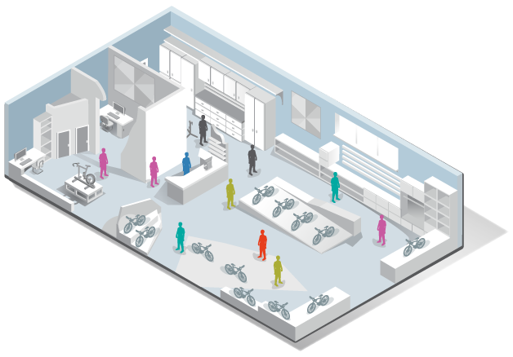
Store and Sales Person Plans
 | Quarter 4 | Quarter 5 | Quarter 6
Open Stores | Banglore | Rio de Janerio | -
Number of Sales People | 20 | 30 | 35
Unit Demand per Office Sales Person | 65 | 120 | 145
Projected Demand | 1860 | 4900 | 7090
Notes:
Update the table above to reflect your store and sales person plans for the future, as well as your projected demand.

Slide 14

Financial Strategy
Increase in Demand and Production to Supply
Reduce prices of old brand and enhance the new bikes
Invest in works force
Look for funds
Spend more on internet marketing

Slide 15
Projected Return on Investment
Total Investment Requested | Per Share | Number of Shares | Return on Investment
$2,500,000 | $125 | 20000 | 228%

